Slide 1


Properties
Of
Fiber

Slide 2

Properties of Fiberglass
Group no 3

Slide 3
Fiber glass?
Preface
Fiberglass is a fiber reinforced polymer made of plastic reinforced by glass fiber, commonly woven into a mat.
Fiberglass is a strong lightweight material and is used for many products. Although it's not as strong and stiff as carbon fiber, it is less brittle, and its raw materials are much cheaper.
Fiberglass refers to a group of products made from individual glass fibers combined into a variety of forms.
Glass Fiber
Continuous fibers

Slide 4
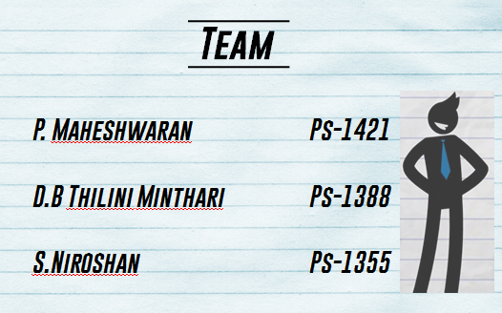
Team
P. Maheshwaran Ps-1421
D.B Thilini Minthari Ps-1388
S.Niroshan Ps-1355

Slide 5
Contents
Introduction
Background
Theory
Results &
Calculations
Observations
Conclusion
Discussion
Future
Aspects

Slide 6
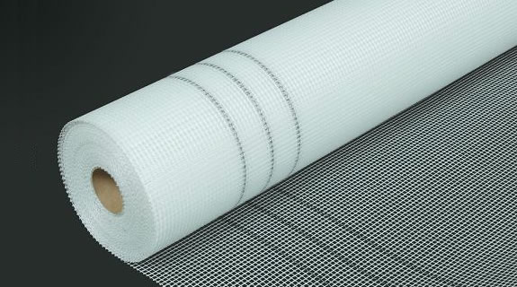
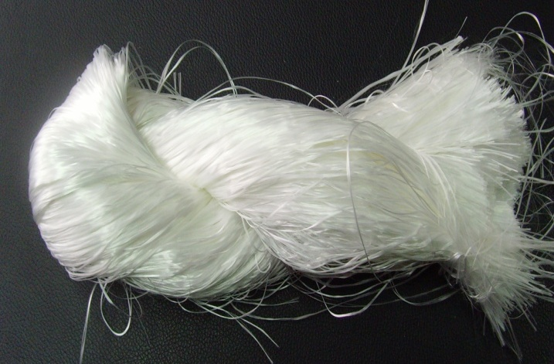
Fiber glass?
Introduction
Fiberglass refers to a group of products made from individual glass fibers combined into a variety of forms.
fibers
Continuous
fibers
Discontinuous
fibers
Glass Fiber
Continuous fibers
Continues
Discontinues

Slide 7
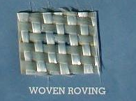
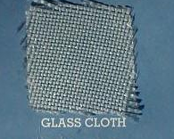
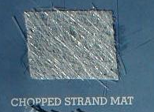
Categories of row materials

Slide 8
The Manufacturing Process
Melting
Forming in to fibers
Continuous-Filament process
Stable-Fiber Process
Chopped Fiber
Glass Wool
Protective Coatings
Quality Control

Slide 9
How Fiber has made?
Fiber Glass
SiO₂ Silicon dioxide
Cao Calsiumoxide
MgO Magnisiumoxide
Al₂O₃ Aluminiumoxide
B₂O₃ Boric oxide

Slide 10
Characteristics of Fiber
A-glass (alkali glass)
which has good chemical resistance, but lower electrical properties.
C-glass (chemical glass)
which has very high chemical resistance.
E-glass (electrical glass)
which is an excellent insulator and resists attacks from water.
S-Glass (structural glass
which is optimized for mechanical properties.
E-glass (dielectric glass)
which has the best electrical properties but lacks in mechanical properties when compared to E and S glass.

Slide 11
Plastic vs. fiberglass
Strength
Weight
Durability
Appearance
Conductivity
Corrosion
Finish
Acoustic Properties
Stability

Slide 12
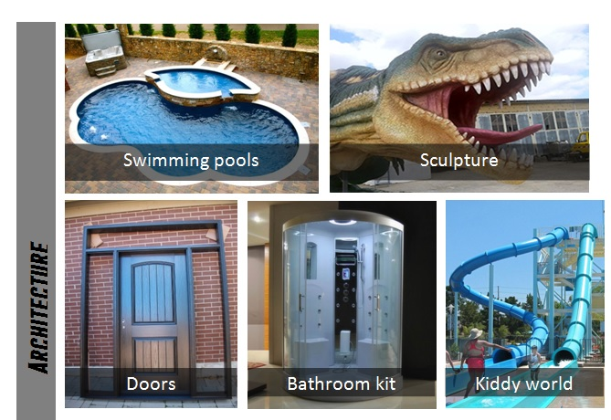
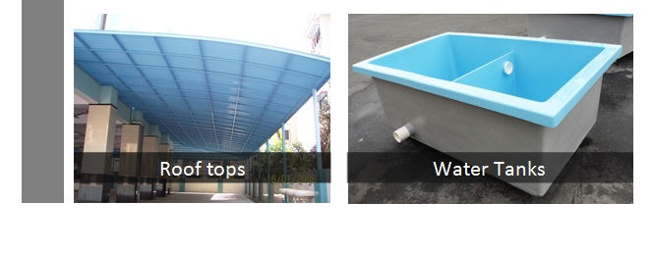
Applications of Fiberglass

Slide 13
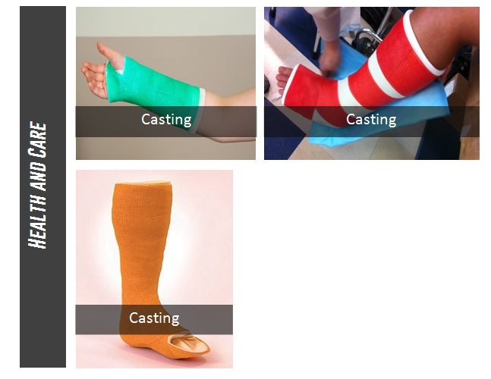
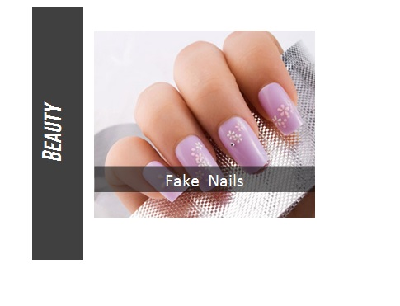

Slide 14
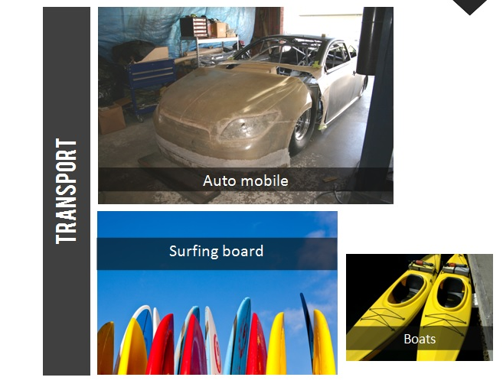
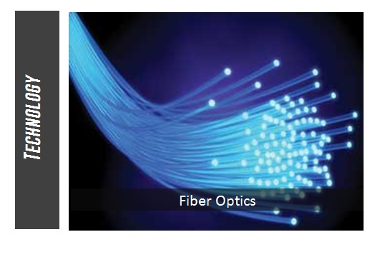

Boats

Slide 15

Whenever you are working with fiberglass use gloves, overalls and a take frequent breaks for fresh air if you are in a confined space.
To reduce the itching of fiberglass try not to scratch . Instead wash the affected areas gently with cool water as often as possible.

Slide 16
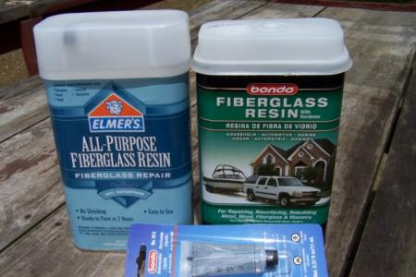
Resin
Row materials

Slide 17
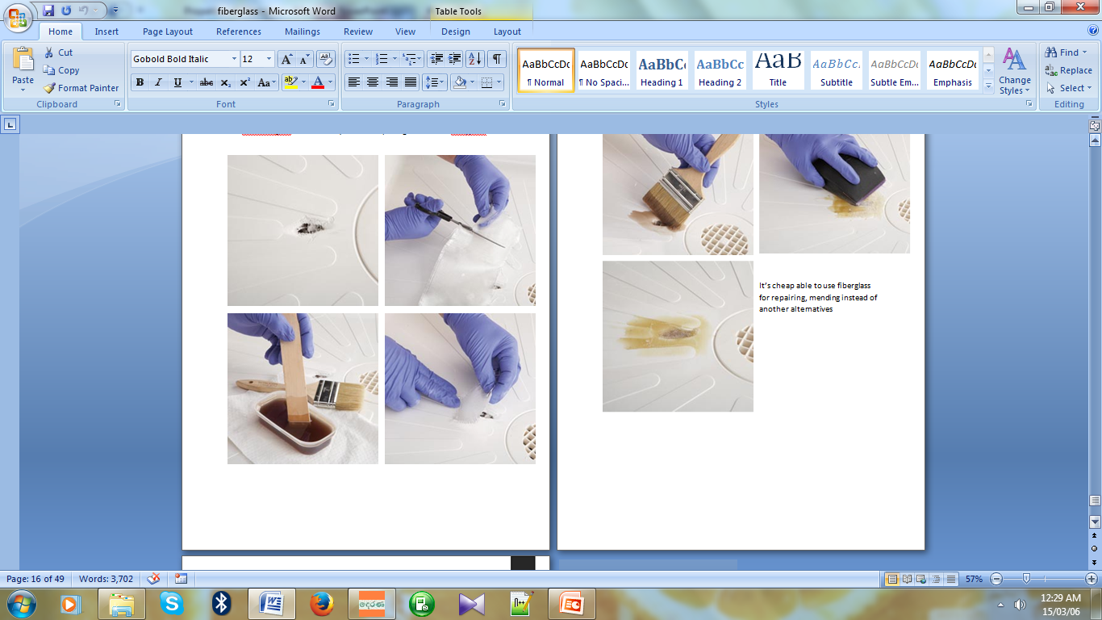
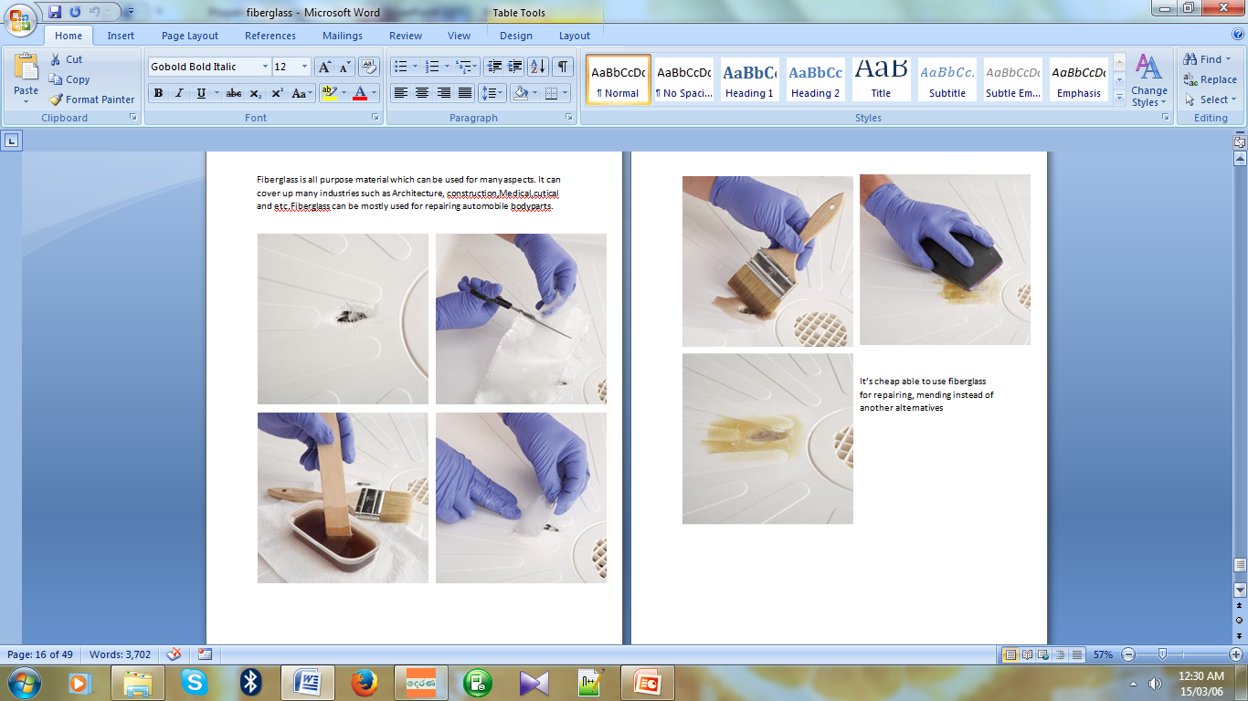
How we made a sample ?

Slide 18
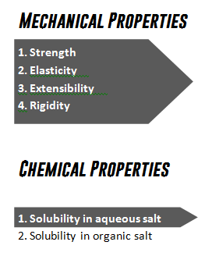
Which Properties we would check
Among list of properties we checked following,

Slide 19
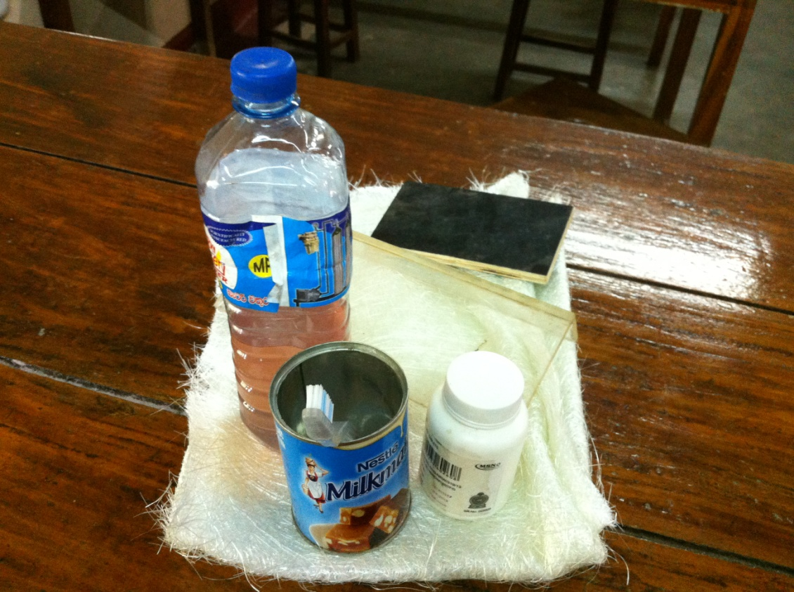
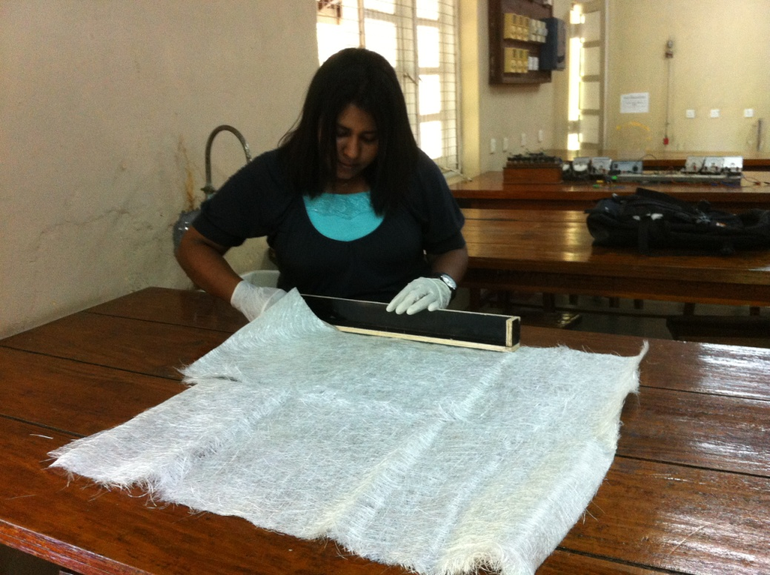
EXPERIMENTAL PROCEDURE
Sample Preparation
Basic row materials used
Splitting into slices

Slide 20
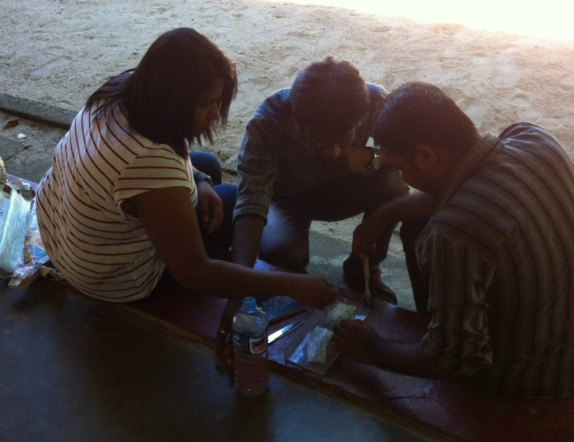
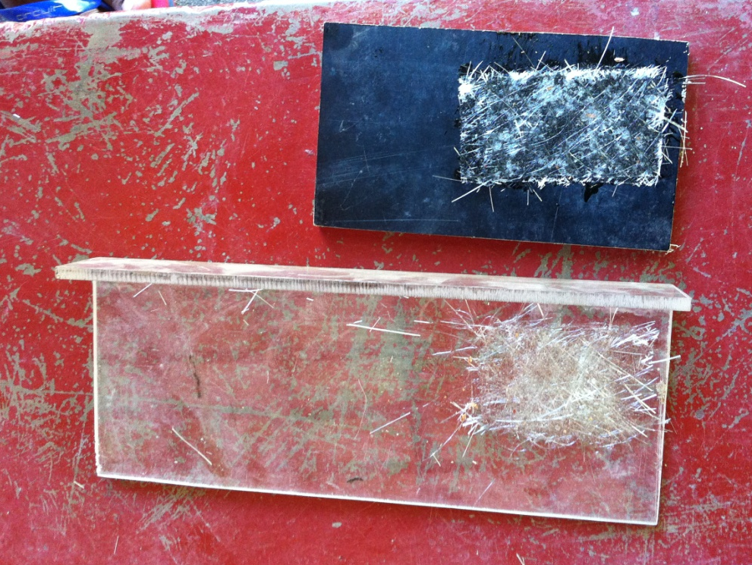
Sample practical was settled up to find the best material to make a mould. Low stickiness was observed in zip board out of glass and wood.
Zip board, glass
Sample test

Slide 21
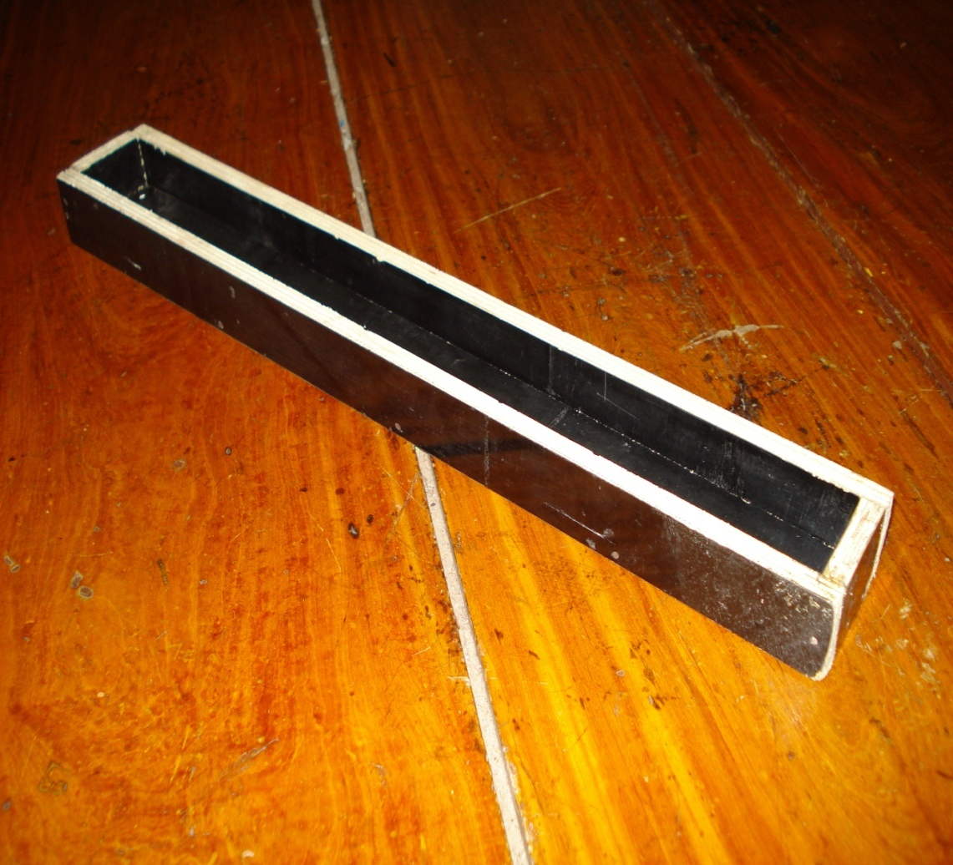
A mould was designed to get identical samples. For the layer 1 only one fiberglass mat was used. Likewise all the samples were prepared up to layer 5, which was stiffer.
Sample Mould

Slide 22
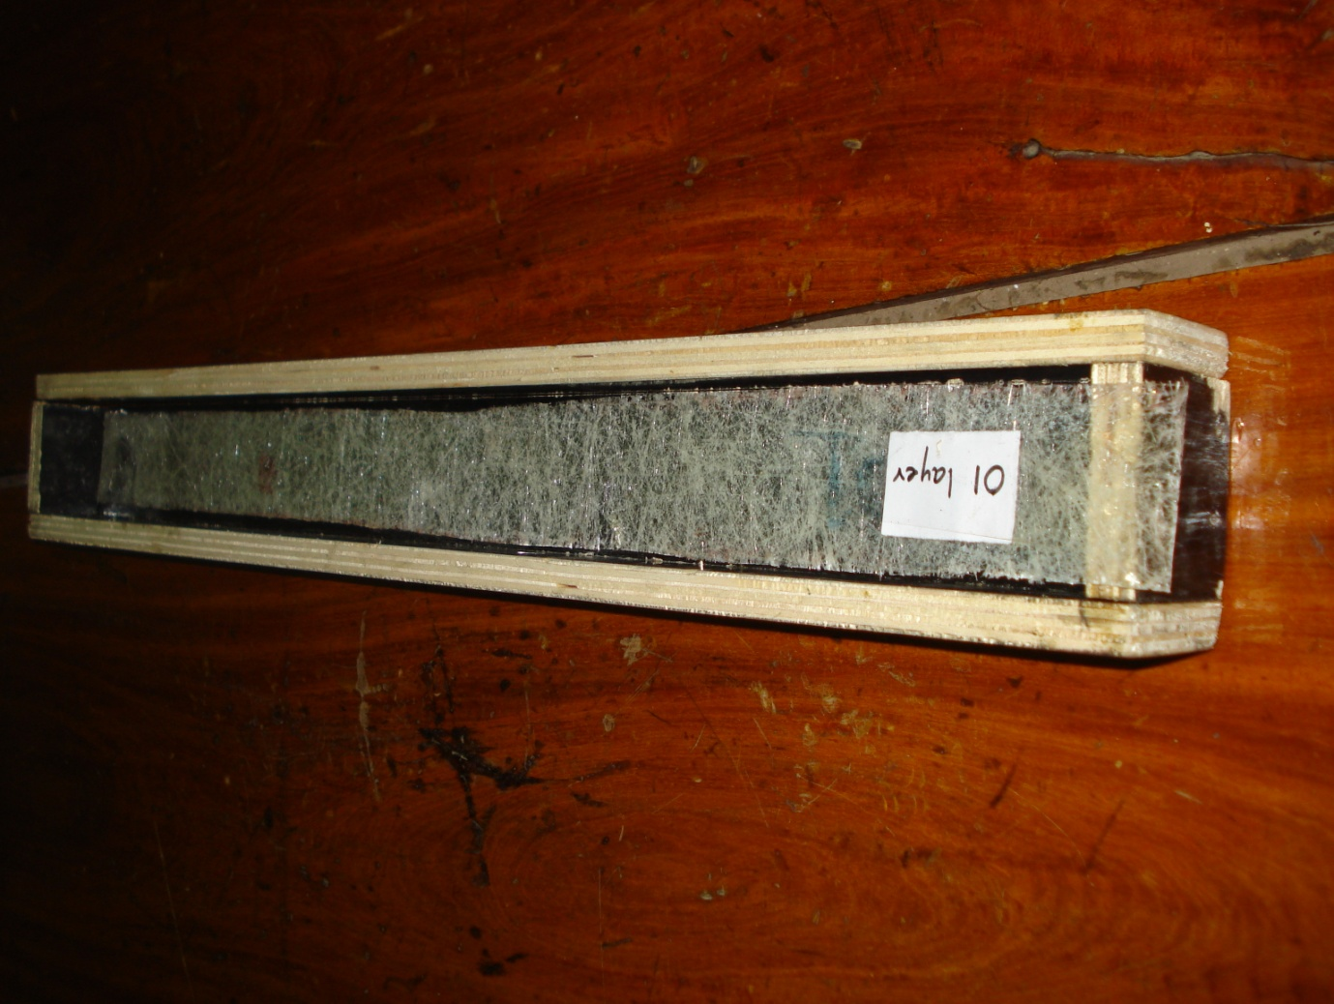
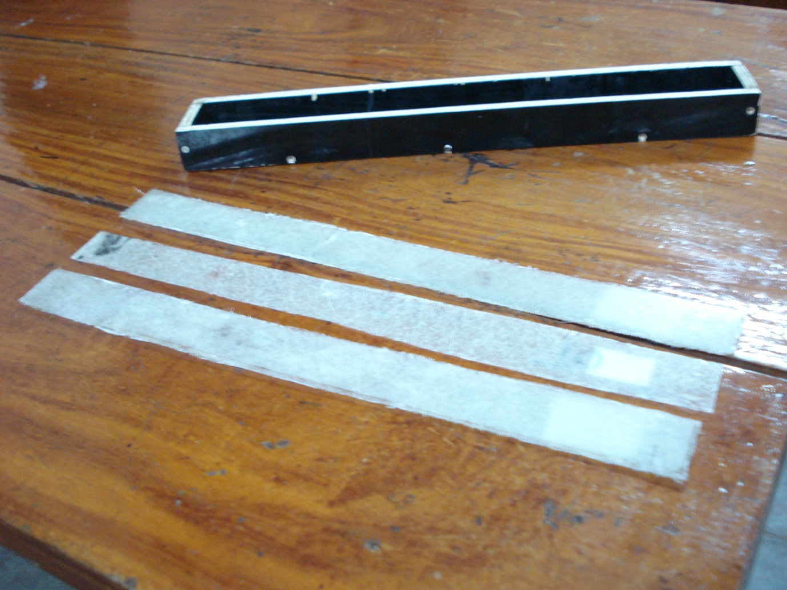
Samples were dried for some time and they were removed from the mould carefully. Each layer was labeled by a number for the easiness of the identification.
Sample Mould with a layer
Carefully removed layers

Slide 23
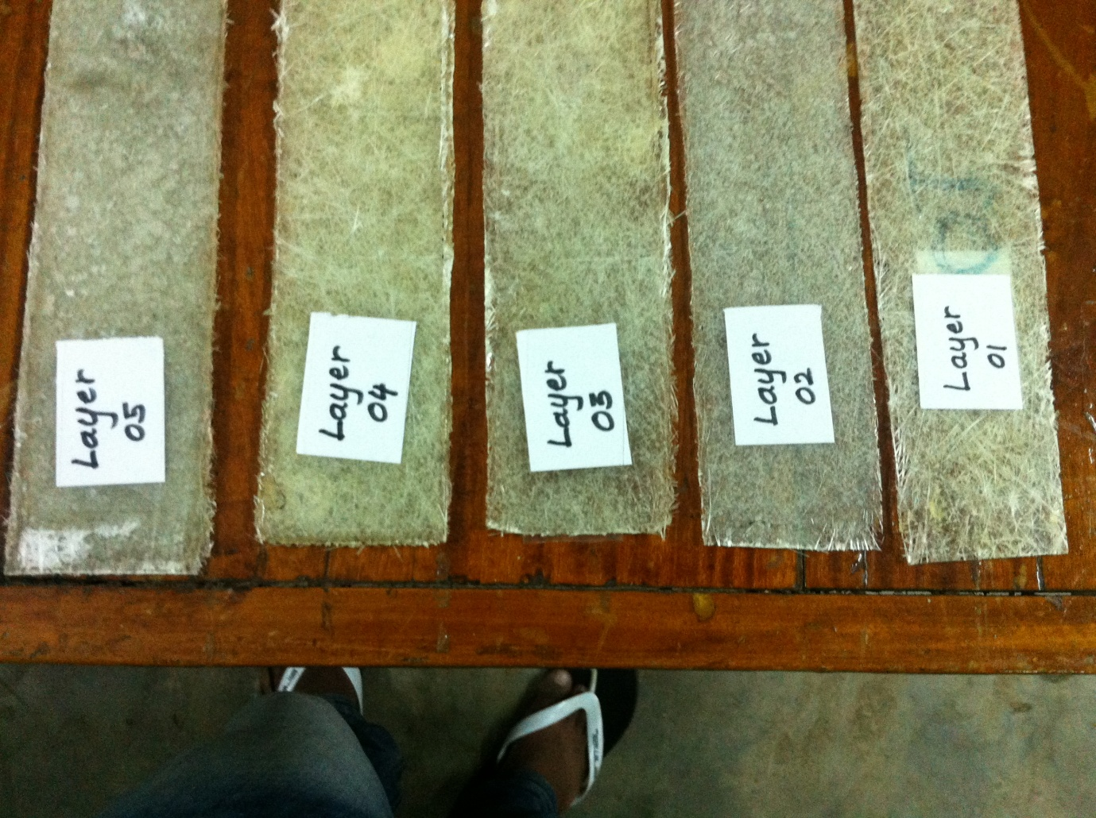
Sequentially numbered layers

Slide 24
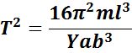
Experimental procedure for young modulus
by Vibration method
If a cantilever of mass m₀ is loaded by a mass m at its end, then the deflection y at end of the cantilever is given by,
Where
l - length of the beam (cantilever)
b - breath of the beam
a - width of the beam
Y -Young’s modulus of the beam

Slide 25
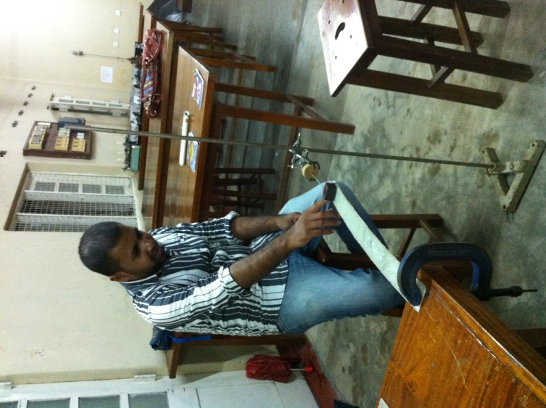
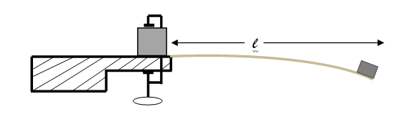
Experiment step
Procedure
Place the unloaded cantilever as show.
Attach the weight to the free end of
the cantilever using a band.
Give a small vibration on the end of the cantilever.
Measure the time for 10 oscillations.
Repeat for several lengths.
Vibration Method

Slide 26
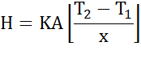
Lee’s Method For Thermal Conductivity
To determine the coefficient of thermal conductivity of fiberglass using Lee's disc apparatus
At the steady state, rate of heat transfer (H) by conduction is given by;
Where,
k - Thermal conductivity of the sample
A - Cross sectional area,
T₂ - T₁ - Temperature difference across the sample.
x - Thickness of the bad conductor

Slide 27
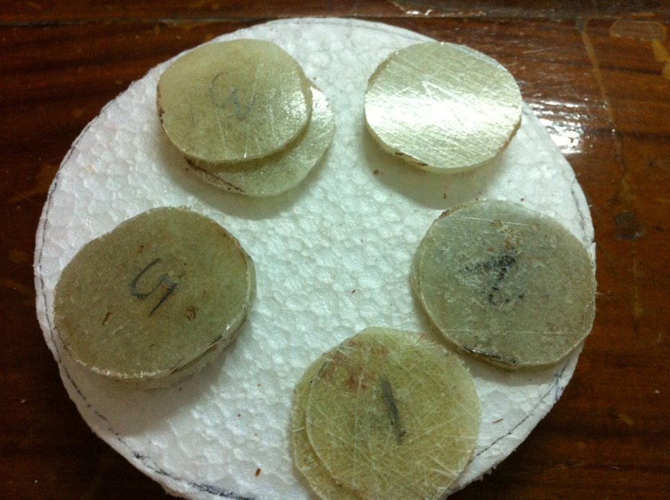
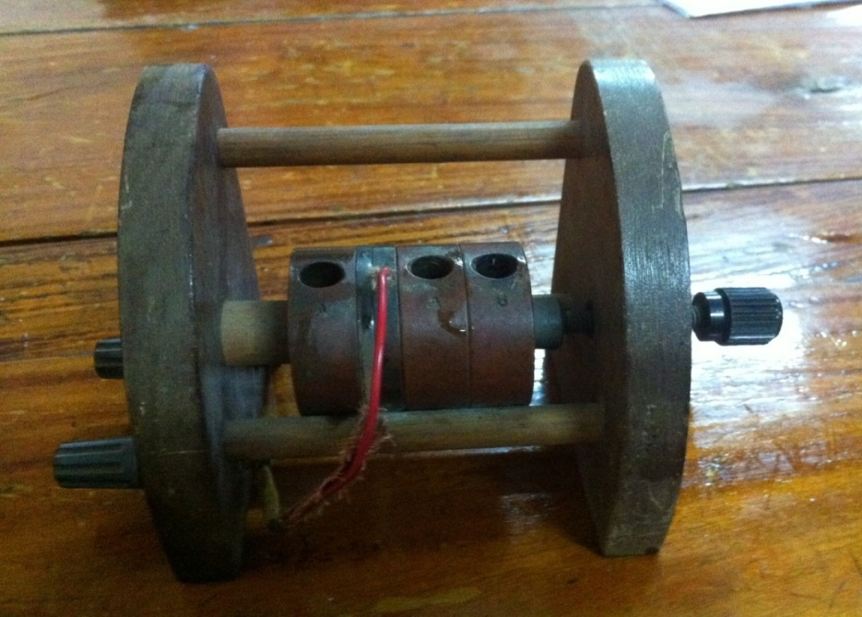
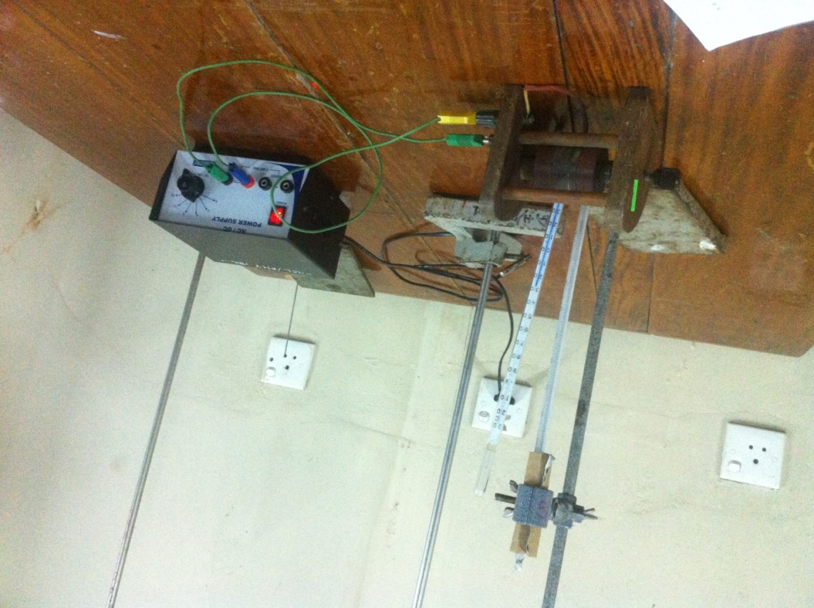
Sliced Fiberglass samples
Lee’s Apparatus
Practical Setup

Slide 28
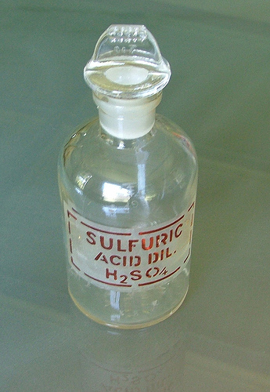
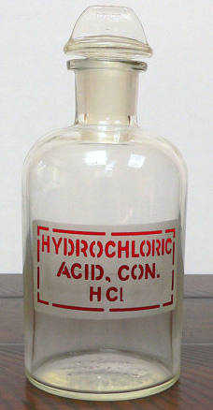
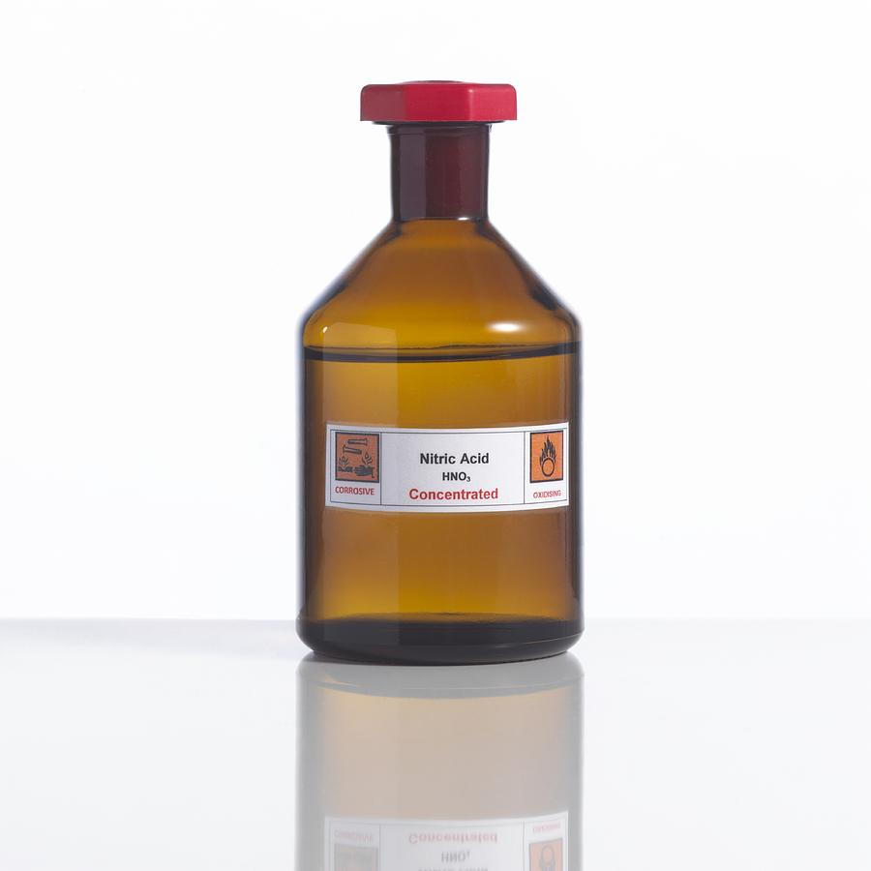
Chemical Reactions
Several chemicals were used to check the chemical reactions in each layer.3 samples from each layer were used each time. Fifteen minutes of time was given for the reaction. Following chemicals were used.HNO₃,H₂SO₄,HCl.

Slide 29
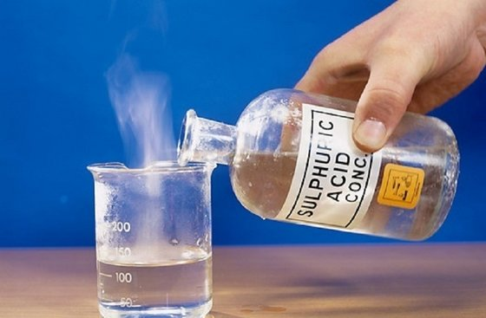
Observations were noted down in each and every time. While some chemicals react with the fiberglass samples some didn’t show any reactions.
Observations

Slide 30
Observations after 15 minutes
Layer # | HNO₃ | H₂SO₄ | HCl
01 | Bubbles appeared | Bubbles appeared | Bubbles appeared
 | Color of sample changed to light yellow | Color of sample changed to dark brown | Gas came out
02 | Bubbles appeared | Bubbles appeared | Bubbles appeared
 | Color of sample changed to light yellow | Color of sample changed to dark brown soon | No color changed could be observed
03 | No bubbles appeared | Color of sample changed to dark brown | Bubbles appeared
 | No reaction observed | Color of chemical changed to light brown | No reaction observed
04 | No bubbles appeared | Color of sample changed to light brown | Bubbles appeared
 | No reaction observed |  | No reaction observed
05 | No bubbles appeared | No bubbles appeared | No bubbles appeared
 | No reaction observed | No reaction observed | No reaction observed
Layer # | HNO₃ | H₂SO₄ | HCl
01 | Bubbles appeared | Bubbles appeared | Bubbles appeared
 | Color of sample changed to light yellow | Color of sample changed to dark brown | Gas came out
02 | Bubbles appeared | Bubbles appeared | Bubbles appeared
 | Color of sample changed to light yellow | Color of sample changed to dark brown soon | No color changed could be observed
03 | No bubbles appeared | Color of sample changed to dark brown | Bubbles appeared

Slide 31
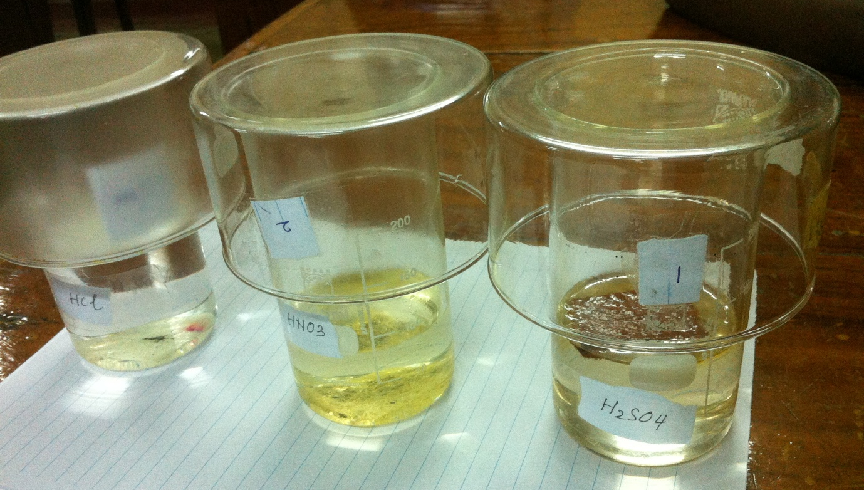
Chemical Reactions Layer 1
Layer 1 was reacted with all chemicals easily

Slide 32
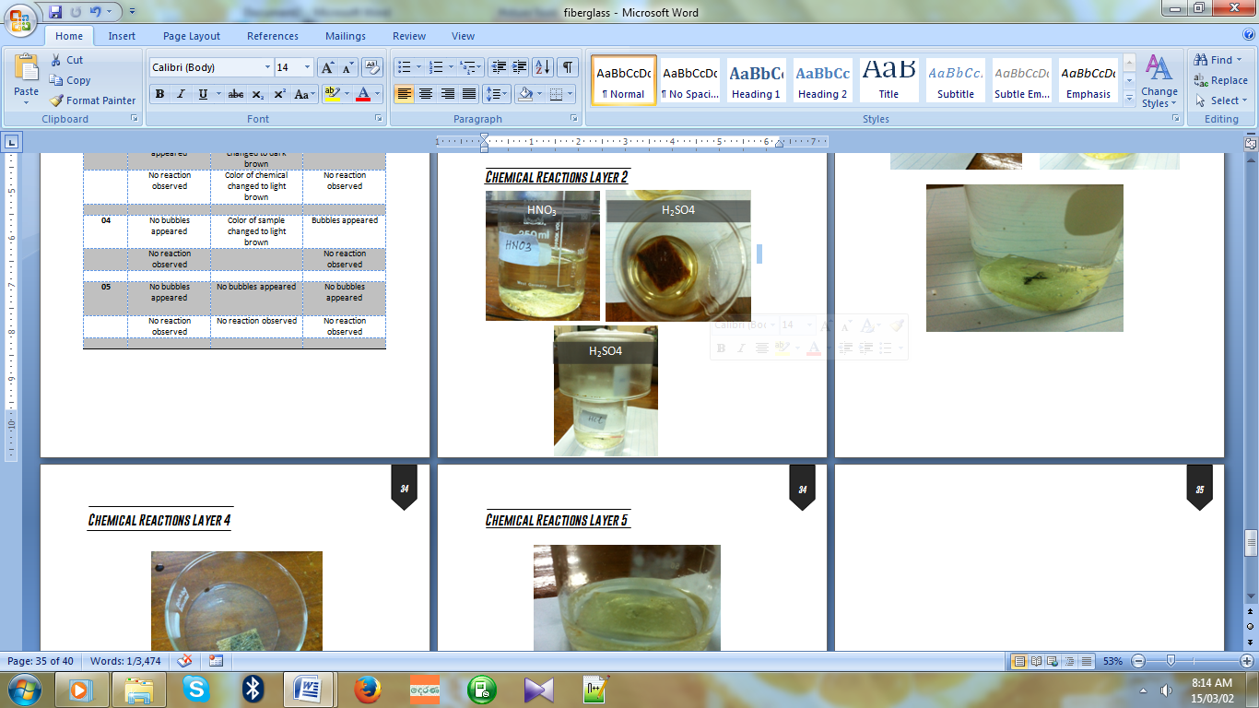
Chemical Reactions for Layer 2

Slide 33
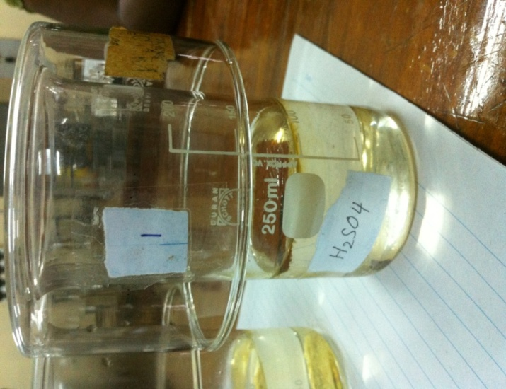
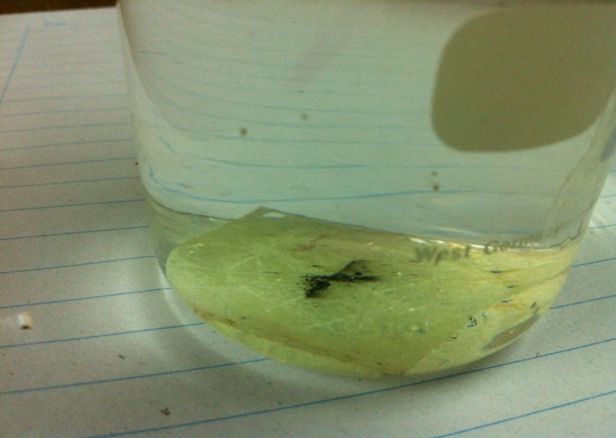
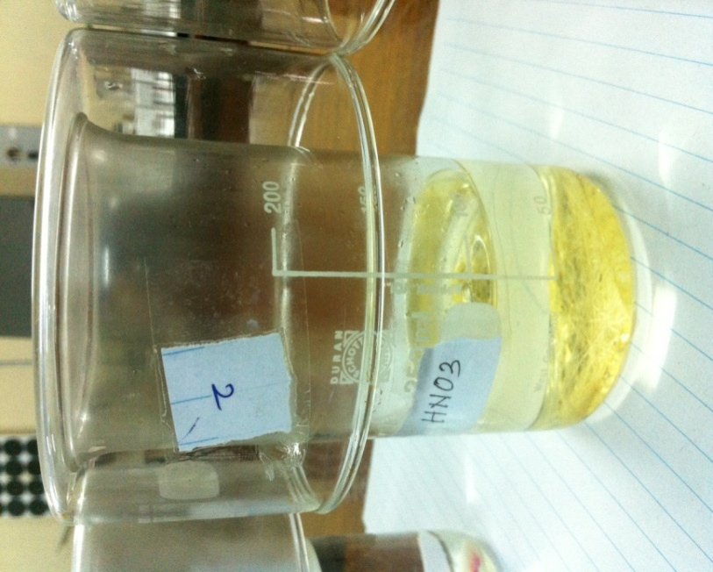
Chemical Reaction Layer 3

Slide 34
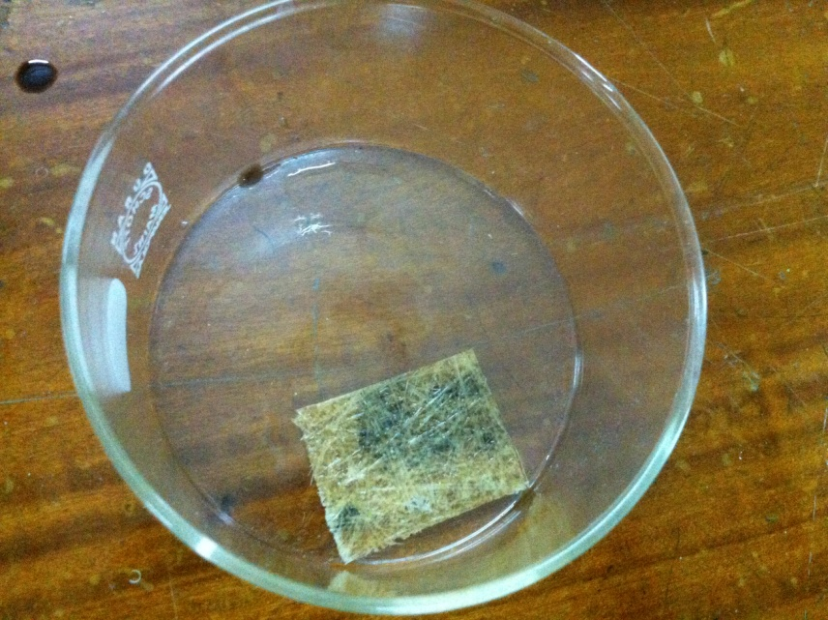
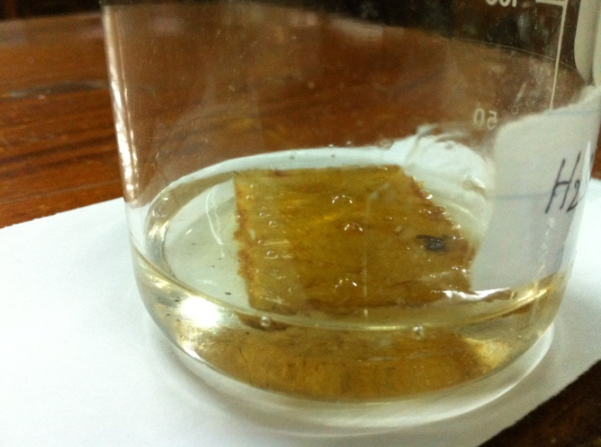
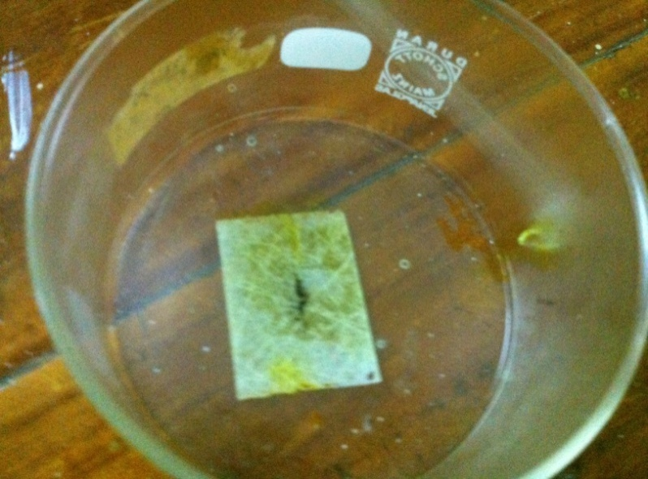
Chemical Reactions Layer 4

Slide 35
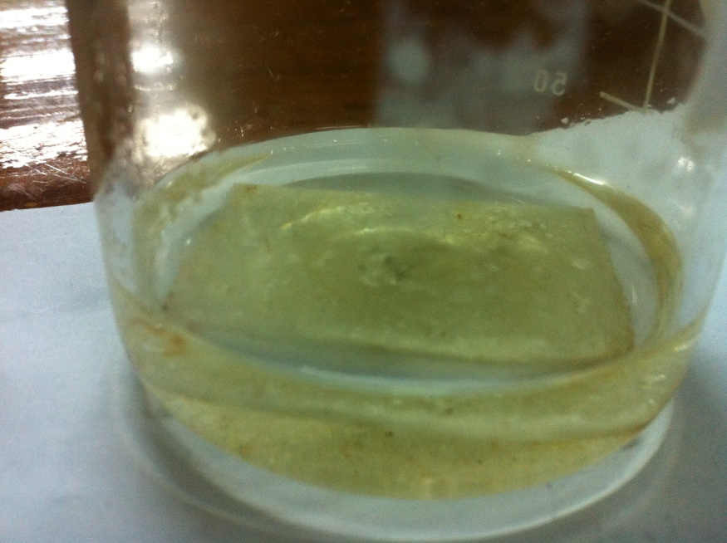
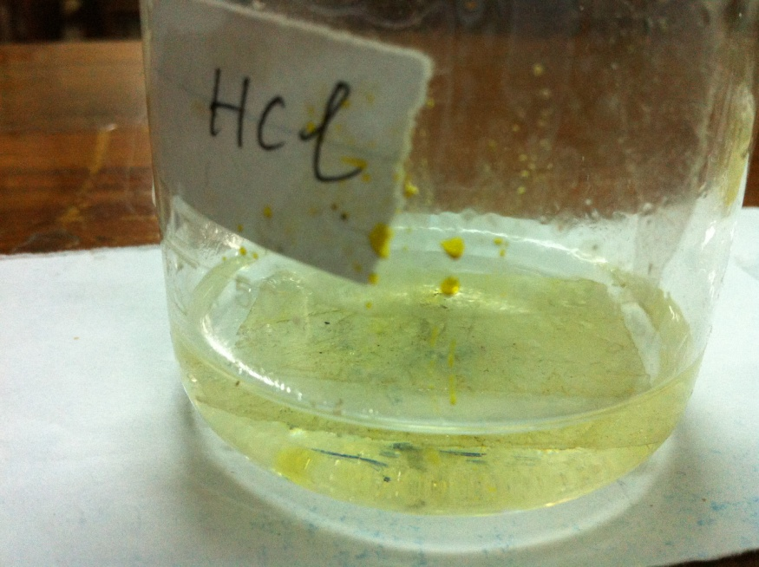
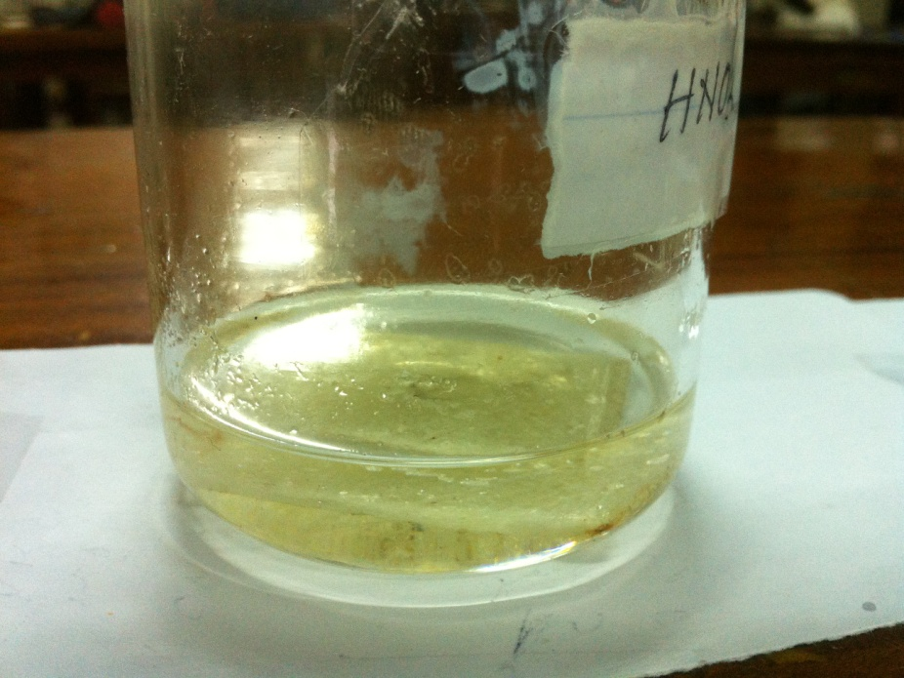
Chemical Reactions Layer 5

Slide 36
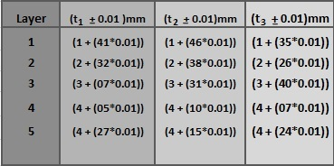
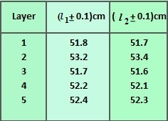
READINGS
Each layer’s width, length and the thickness were recorded for future aspects.
Thickness of the layers
Length of the layers

Slide 37
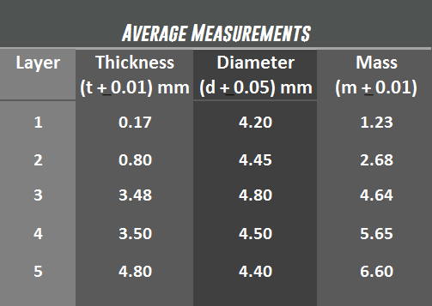
Lee’s Method
g

Slide 38
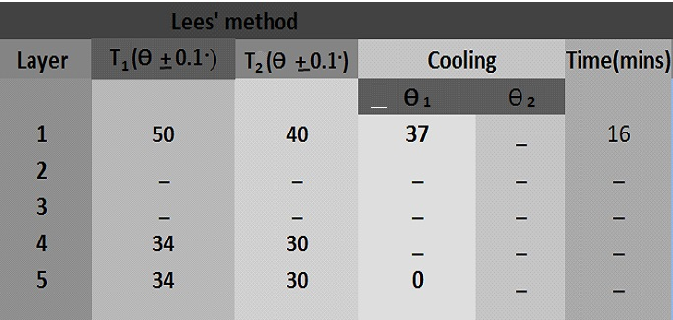
Lees Method for Calculating Thermal Conductivity

Slide 39


CALCULATIONS
Average thickness of the layers
Average length of the layers

Slide 40


GRAPHS
2
The graph of (time) versus (length)
3

Slide 41


The graph of (time) versus (length)
2
3

Slide 42


The graph of (time) versus (length)
2
3

Slide 43

Using the graph for layer 3

Slide 44

Using the graph for layer 4

Slide 45

Using the graph for layer 5

Slide 46
CONCLUSION

Slide 49


Slide 50
DISCUSSION
True values and the practical values can be differ due to the amount of resin land catalyst used. Mainly resin and catalyst are the main things that should be considered when comparing layers.
Thermal conductivity of the samples and also the young modulus of the samples can be varied due to the thickness of layer. Thickness could be varied due the resin and catalyst used.

Slide 51
Future Aspects
Whenever you are working with fiberglass use gloves, overalls and a take frequent breaks for fresh air if you are in a confined space.
To reduce the itching of fiberglass try not to scratch . Instead wash the affected areas gently with cool water as often as possible.
As the fiberglass is a heavy less and inexpensive material it can be used for building houses. Due to earthquakes people suffering from rebuilding their assets. It’s better to use fiberglass to build their hoses behalf of traditional materials.
Moreover people can use fiberglass for architectural purposes as fiber can be bendable and can be formed into many forms. Behalf of plaster of parish fiber can be introduced .

Slide 52
Thank You

